Slide 1
Case Study: Building a Sentiment-Driven Investment Scoring Model
Develop an automated system that uses news sentiment to identify promising investment opportunities, validates
them with financial data, and produces a final, unified score. Compare each target company against its peers to provide a clear, explainable investment thesis.
Problem
Market-moving news breaks continuously across dozens of outlets - far faster than analysts can manually screen for investable signal
Sentiment alone is noisy and easily misleading without quantitative validation
A company's score means little in isolation - it needs peer context to be defensible
No existing workflow unifies sentiment, fundamentals, and peer comps into one explainable investment score
Objective
NER extraction from news articles - to identify companies mentioned in the article confidently
Assess whether the article is relevant for the company or just incidentally mentioned and how confident
Calculate the sentiment of the news articles to structure signals
Assess the fundamentals of the company and have an integrated score including sentiment factor
Identify relevant peers and do peer comp analysis to have an investment thesis
Data Sources
News & sentiment: Google News RSS, NewsAPI, Alpha Vantage, Yahoo Finance, Benzinga
Fundamentals & valuation: yfinance, Alpha Vantage company data
Entity reference: SEC EDGAR company tickers, S&P 500 constituents (for NER matching)

Slide 2
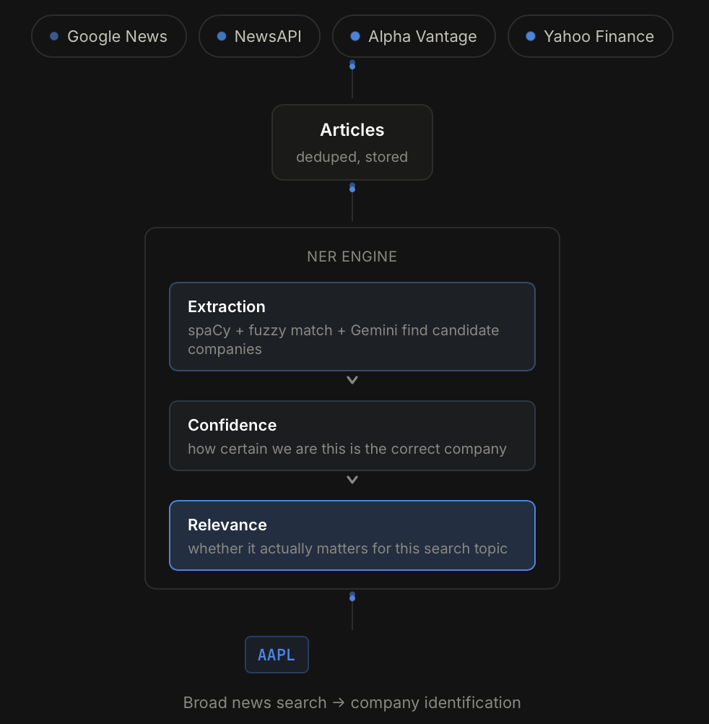
Pipeline & Model Architecture
1 INGEST
Keyword search across 4 news sources (Stage A)
→
2 IDENTIFY
NER ensemble links articles to tickers
→
3 DEEP INGEST
Ticker-scoped history, 5 sources (Stage B)
→
4 SCORE SENTIMENT
FinBERT + LLM ensemble, 5-tier label per article
→
5 AGGREGATE
Inflection/turnaround detection -> shortlist of 5
→
6 SCORE & COMPARE
Fundamentals + sentiment composite vs. 3 peers
NER ARCHITECTURE — dual extraction, agreement stacks confidence
SENTIMENT ARCHITECTURE — agreement flagged, not blended
– spaCy (en_core_web_trf) extracts ORG spans, fuzzy-matched (rapidfuzz) against SEC EDGAR's ~7,600 canonical issuers
– Gemini Flash-Lite: batched structured extraction (15 articles/call) returns company, confidence, supporting quote
– Quotes are checked against source text; ungrounded LLM mentions are discounted 0.3x (hallucination guard)
– Combined via noisy-OR: combined = 1 - (1-conf_spaCy)(1-conf_LLM) — independent agreement stacks evidence
– Relevance (High/Med/Low, investor-lens) scored by the LLM separately — gates default selection, not identity
– FinBERT scores only the ticker-focused snippets (sentence-split + name match), not the whole article
– Gemini Flash-Lite reads the full article, ticker-aware, quote-grounded (same hallucination guard as NER)
– Bucketed to Alpha Vantage's 5-tier scale (Bullish→Bearish) using AV's own published numeric thresholds
– Ordinal agreement, not noisy-OR: Agree/Conflict by rank distance; LLM label wins on conflict, conflict still surfaced
– Validated on real data: 67% exact-label agreement, 98% directional (polarity) agreement between methods

Slide 3
Scoring Logic and Rationale
VALUE
default wt. 20%
→
QUALITY
default wt. 20%
→
GROWTH
default wt. 20%
→
MOMENTUM
default wt. 20%
→
SENTIMENT
default wt. 20%
=
COMPOSITE SCORE (0-100)
FUNDAMENTAL FACTORS — weighted z-score per factor
SENTIMENT FACTOR & COMPOSITE — how it's added in
– Value: trailing/forward P/E, P/B, P/S, EV/EBITDA, FCF yield, shareholder yield (cheaper = higher z)
– Quality: revenue growth, gross/operating/net margin, ROE, ROA, debt/equity, cash conversion
– Growth & Momentum: revenue trajectory; 12-1 month vol-adjusted momentum vs. sector and market
– Each metric z-scored (own trailing history, or vs. 3 peers for comps) then weighted-averaged into a factor z: Σ(z·w)/Σw
– Metric weights default equal within each factor — adjustable and lockable per company
– Built from 3 confidence-weighted sentiment windows — Recent (0-3d), Mid (4-14d), Historical (15-30d) — on a Bearish(-2)...Bullish(+2) scale
– Default window blend: 70% Recent / 30% Mid / 0% Historical — recent news carries the signal; older news is already priced in
– Windows below a 3-article volume floor are excluded, never zero-filled, so thin news can't silently drag the score
– Sentiment is a 5th factor, not a bolt-on: composite = weighted z-average of Value, Quality, Growth, Momentum, Sentiment, mapped through the normal CDF to 0-100
– Default: equal 20% per factor — every weight is user-adjustable and lockable for consistent peer comparison

Slide 4
Results and Peer Comps

Slide 5
Investment Theses

